Slide 1

Chapter 4 Comments

Slide 2
Why do we need comments?
Document for public reference
Help you recognize and memorize code
To express your intent better

Slide 3
Comments Do Not Make Up for Bad Code
Don’t comment bad code—rewrite it
Brian W. Kernighan
Notes:
Clear and expressive code with few comments is far superior to cluttered and complex
code with lots of comments.

Slide 4
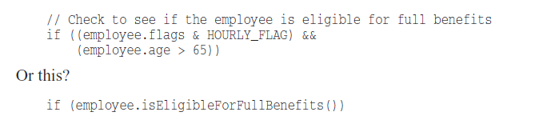
Explain Yourself in Code
Notes:
Which one do you prefer?

Slide 5
Good
Legal comments
Though prefer to use a file with name LICENCE

Slide 6


Good
Informative Comments
responderBeingTested()

Slide 7
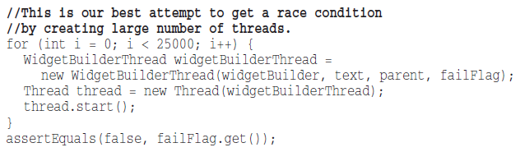
Good
Explanation of Intent
Notes:
Important decisions that can be questionable by other programmers

Slide 8
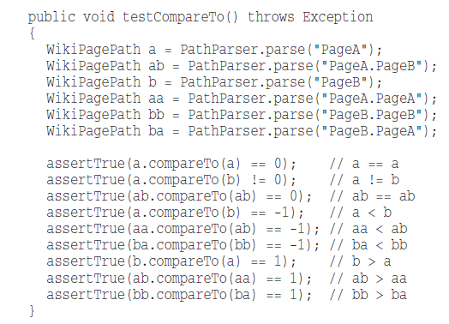
Good
Clarification
Notes:
This type of comments are risky, do it with care

Slide 9
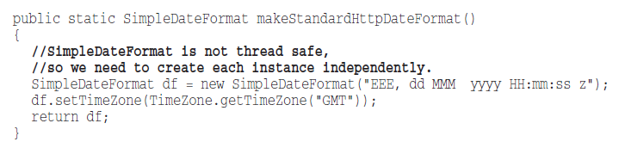
Good
Warning of Consequences

Slide 10
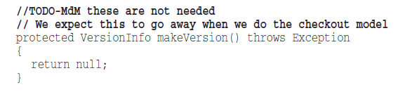
Good
TODO comments

Slide 11
Types of TODO
Task to be done or implemented
Reminder to delete a deprecated feature
Request for someone else to think for a better way
Notes:
Whatever else a TODO might be, it is not an excuse to leave bad code in the system.

Slide 12
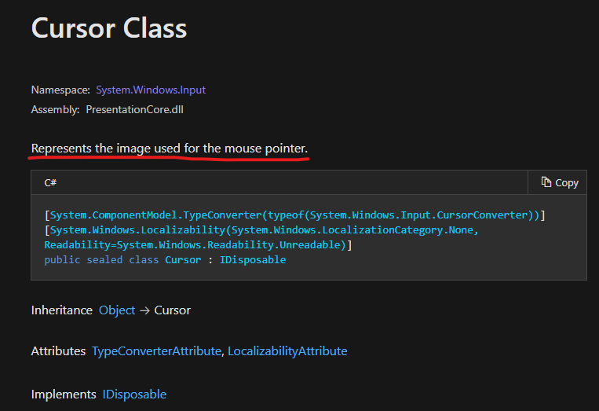
Good
Public APIs

Slide 13
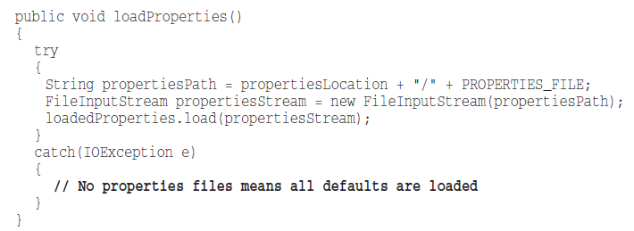
Bad
Mumbling
Notes:
mumbling means talking to yourself in your mouth
Questions about this bit of code:
- Who loads all the defaults?
- Were they loaded before the call to loadProperties.load?
- Was the author trying to comfort himself about the fact that he was leaving the catch block empty?
- Was the author trying to tell himself to come back here later and write the code that would load the defaults?

Slide 14
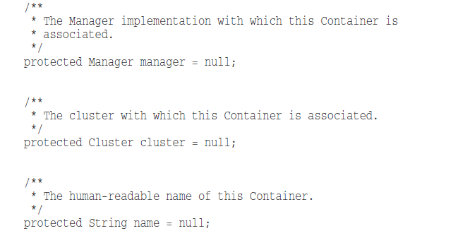
Bad
Redundant Comments

Slide 15
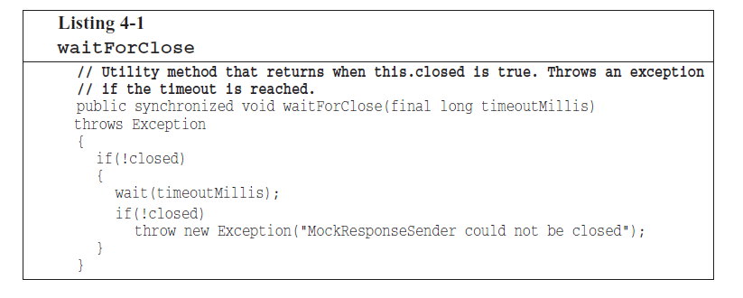
Bad
Misleading Comments
Notes:
This function does not return when this.closed is true
it returns If this.closed is true
Programmer expects that as soon as this.closed becomes true this function will return

Slide 16
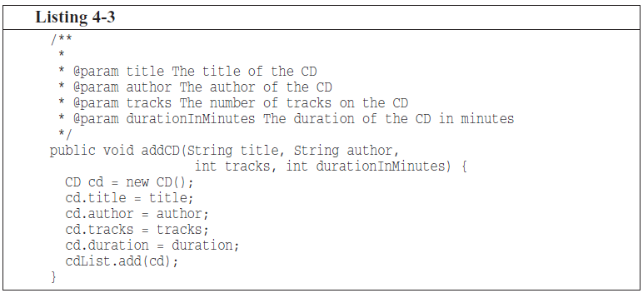
Bad
Mandated Comments
Notes:
Mandated means => اجباری
Not all functions and variables should have java do

Slide 17
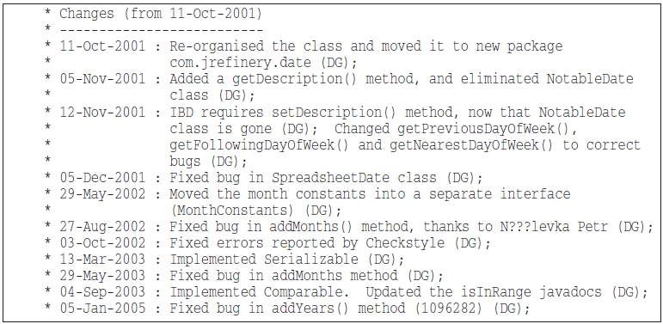
Bad
Journal Comments
Notes:
You can use GIT or other types of version control system to keep these for you!

Slide 18
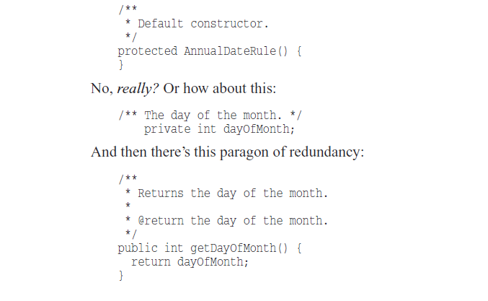
Bad
Noise Comments

Slide 19
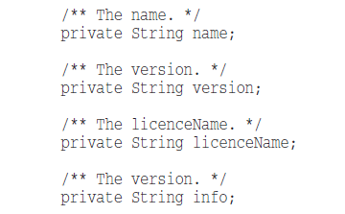
Bad
Scary Noise
Notes:
Do you see the cut-paste error?
If authors aren’t paying attention when comments are written (or pasted),
why should readers be expected to profit from them?

Slide 20


Bad
Don’t use comment when you can use a function or variable

Slide 21
Bad
Position markers

Slide 22
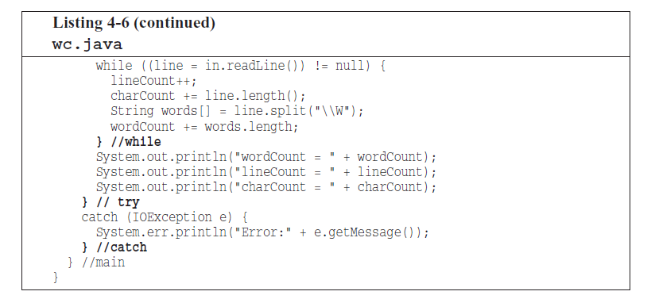
Bad
Closing brace comment

Slide 23

Bad
Attributions and Bylines
Notes:
Source code control systems are very good at remembering who added what, when.

Slide 24
Tool: GitToolbox for Intellij Gitlense for VsCode
It helps you to visualize code authorship at a glance via Git blame annotations and code lens

Slide 25
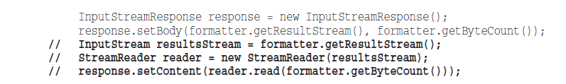
Bad
Commented-Out code
Notes:
Others who see that commented-out code won’t have the courage to delete it.
Are they important?
ere they left as reminders for some imminent change?

Slide 26
Tool: Gist for Github Snippet for Gitlab
Gist is a simple way to share code snippets and pastes with others. It is used when you need to share a sample piece of code or technique with your co-workers or friends.

Slide 27
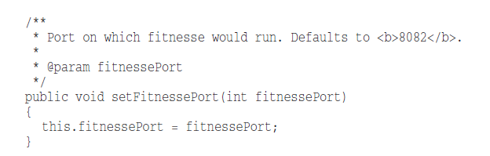
Bad
Nonlocal information
Notes:
Referencing global configurations and information in a local function will quickly turn it into a lie when those information changes

Slide 28
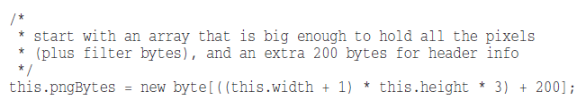
Bad
Inobvious connection
Notes:
What is a filter byte?
Does it relate to the +1?
Or to the *3?
Both?
Is a pixel a byte?
It is a pity when a comment needs its own explanation.

Slide 29
Vocabulary: Changelog
A changelog is a log or record of all notable changes made to a project.
https://keepachangelog.com/en/1.1.0/
https://semver.org/
Notes:
https://docs.microsoft.com/en-us/dotnet/csharp/whats-new/csharp-9
https://github.com/material-components/material-components-android/releases
https://github.com/google/dagger/releases

Slide 30
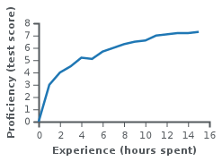
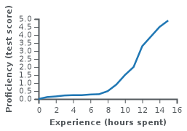
Vocabulary: Learning curve
Relationship between Proficiency and Amount of time you spend to learn something To do a task as Done.
Notes:
Use learning curve theory to:
Choose between tools to work with.
Estimate your work on R&D tasks

Slide 31
Thank You!

